Slide 1




WEEKLY UPDATE
SSGA Field Project, Team Brandeis
11.29

Slide 2
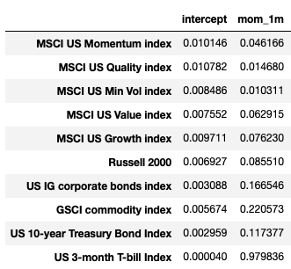
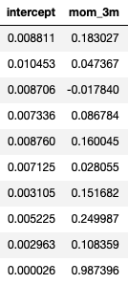
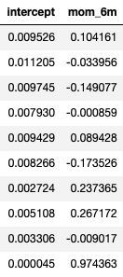
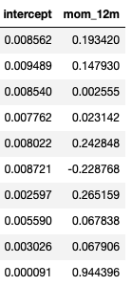
Part 1: 4 linear regression model by using 1,3,6,12 month moving average return variable.

Slide 3
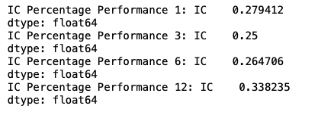
Part 2: Detect Strength of Explanation by Information Correlation
The 1-month and 12-month Moving Average Returns do have better predictive power

Slide 4
Part 3: Four Model Correlation Matrix
 | 1m | 3m | 6m | 12m
1m | 1
3m | 0.75 | 1
6m | 0.67 | 0.86 | 1
12m | 0.54 | 0.7 | 0.8 | 1
3-month and 6-month moving average yield models have a significant overlapping effect with the 1-month and 12-month models
3 month is closer to 1 month.
1-month, 6-month and 12-month models are chosen to predict momentum.

Slide 5
Final Momentum Model
40%*1-month model +40%*12-month model + 20%*6-month model

Slide 6
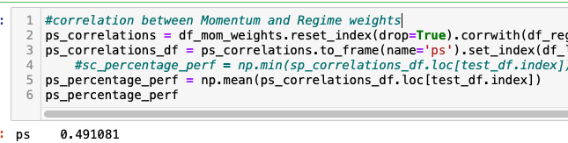
Portfolio Weights (Method 1)
Since the correlation is 0.5, assumption 1 is giving 50% to the weights from market regime and momentum separately

Slide 7
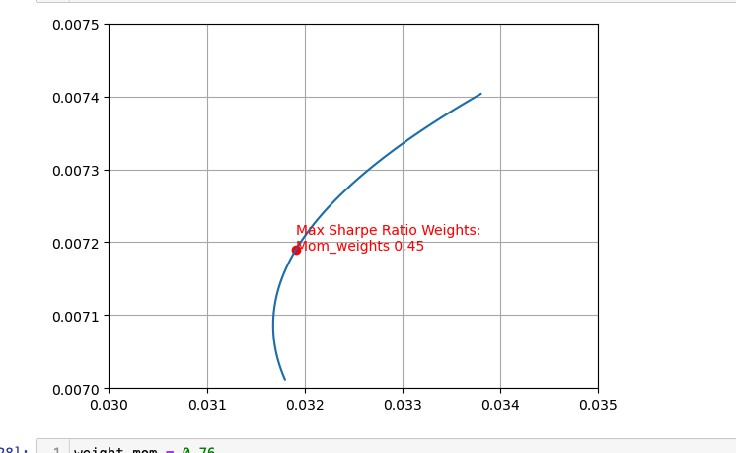
Portfolio Weights (Method 2)
View the weights of the market regime and momentum as two portfolio
Draw the efficient frontier and choose point with maximize sharpe ratio
45% for momentum weights; 55% for market regime weights

Slide 8
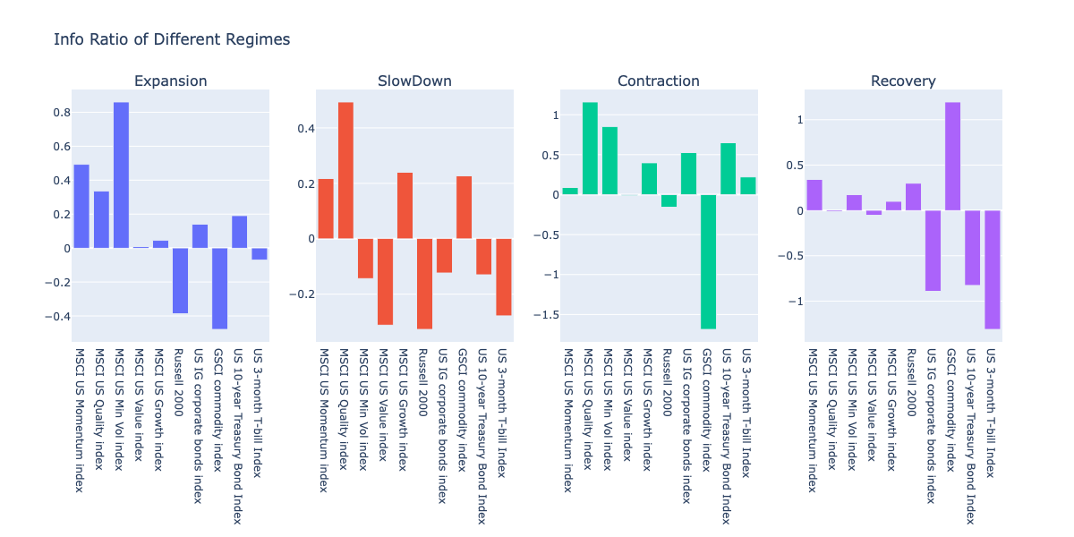
Principle Component Analysis

Slide 9
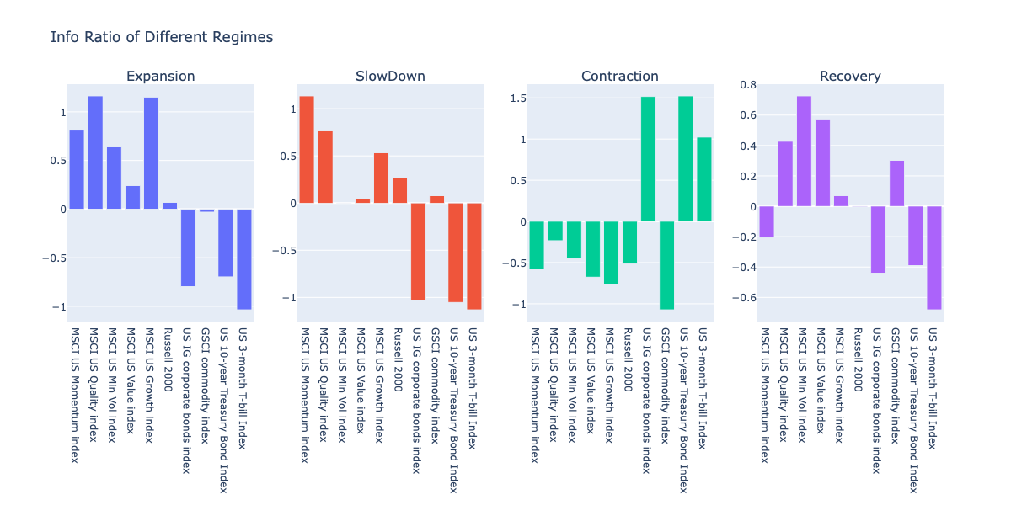
Without Principle Component Analysis

Slide 10
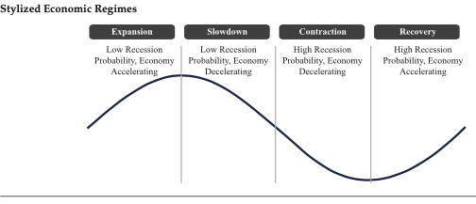
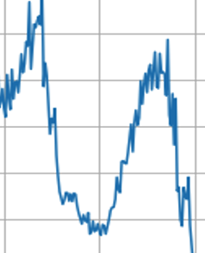
Indicators for Market Regime Detection
Stock Market Perspective: S&P500
S&P500 lag1 (last month’s return)
S&P500 3-month difference
Bond Market Perspective : US 3-month T-bill Index
US 3-month T-bill Index 3_month difference
Risk Level Perspective: VIX
VIX 3-month difference
Macro Data Perspective: Percentage Change of CPI + PMI
Percentage Change of CPI + PMI 3-month difference
DXY
Notes:
The first reveals the market regime from a stock market perspective.
Together, these four perspectives produce a more objective and comprehensive market regime.

